Slide 1
Ayurvedic Diet Recommendation System
M. Aditi Madhumitha-24N31A05Q5
M.Vennela-24N31A05Q6
K. Ragya Naik-24N31A05L0

Slide 2
ABSTRACT
The Ayurvedic Diet Recommendation System is a web-based application developed to provide personalized diet suggestions based on a user’s health information. The system collects basic details such as name, age, height, weight, and selected health issues, and then calculates the user’s Body Mass Index (BMI) to determine their health category. Based on this information, the application recommends suitable Ayurvedic food items and suggests foods that should be avoided for better health management. The system is developed using Python with the Flask framework, along with HTML and CSS for the user interface, and SQLite database to store patient details and health records. The main goal of this application is to promote healthier dietary habits using Ayurvedic principles while providing a simple, efficient, and user-friendly platform for users.

Slide 3
Introduction
The application recommends Ayurvedic diet plans based on user health conditions.
Users enter name, age, height, weight and health issues.
The system calculates BMI and suggests foods to eat and avoid.
Patient details are stored in a database.

Slide 4
Existing System
Patient records are maintained using paper files.
Diet suggestions are given manually by dieticians.
Managing large patient records is difficult.
Paper records can be lost or damaged.

Slide 5
Proposed System
A web application that automates Ayurvedic diet recommendations.
Users enter health information through a digital form.
The system calculates BMI and suggests diet automatically.
Patient data is stored in a database.

Slide 6
Software Tools Used
Frontend: HTML, CSS, JavaScript
Backend: Python (Flask)
Database: SQLite
IDE: Visual Studio Code
Version Control: GitHub
Browser: Chrome,edge

Slide 7
Hardware Tools
  Desktop or Laptop
  Intel i3 Processor or above
  4 GB RAM
  Internet Connection

Slide 8
UML Diagrams

Slide 9
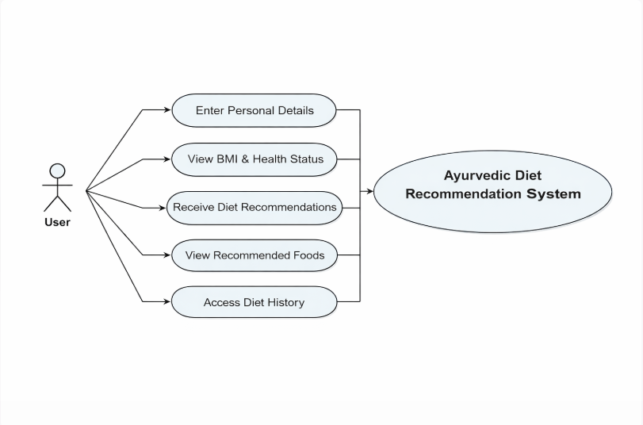
Use Case Diagram

Slide 10
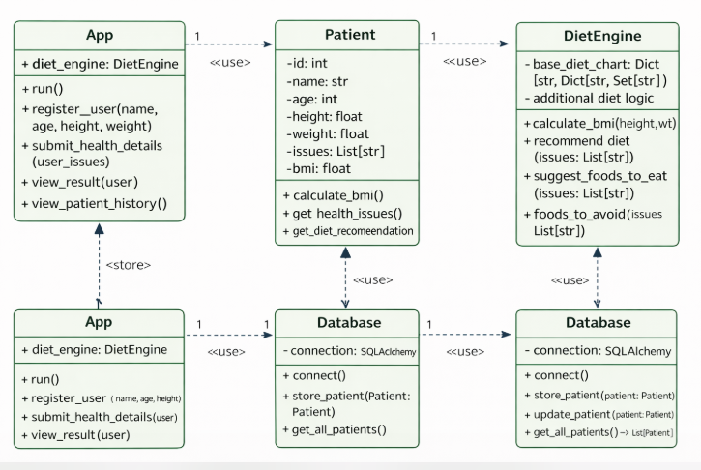
Class Diagram

Slide 11
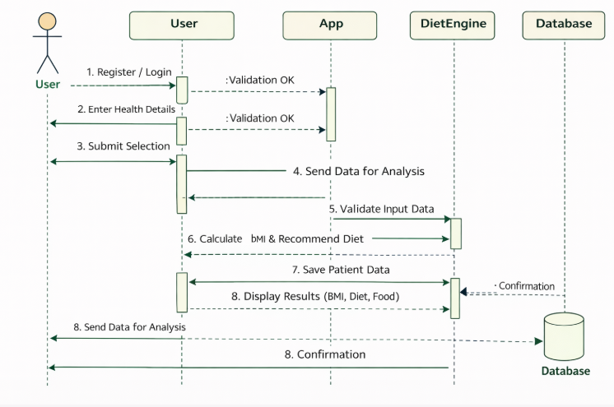
Sequence Diagram

Slide 12
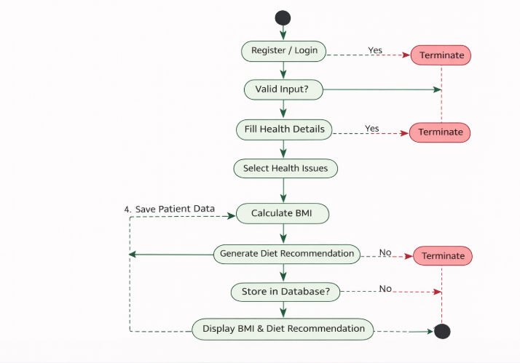
Activity Diagram

Slide 13
Implementation
The Ayurvedic Diet Planner uses Python Flask as the backend to handle server logic and data management.
HTML is used to create the structure of web pages, while CSS styles them for a user-friendly interface.
The system collects user inputs like name, age, weight, height, and health conditions through forms.
Flask routes process these inputs and generate personalized diet recommendations based on Ayurvedic principles.
The combination of Flask, HTML, and CSS ensures dynamic interaction and a responsive, visually appealing web application.

Slide 14
Sample Code
from flask import Flask, request
from flask_sqlalchemy import SQLAlchemy
app = Flask(__name__)
db = SQLAlchemy(app)
class Patient(db.Model): id = db.Column(db.Integer, primary_key=True); name = db.Column(db.String(100))
@app.route("/result", methods=["POST"])
def result():
db.session.add(Patient(name=request.form["name"]))
db.session.commit()
return "Patient added!"
if __name__ == "__main__":
app.run(debug=True)
Sample code of app.py

Slide 15
<form action="/result" method="POST">
Name: <input name="name" type="text" required><br>
Age: <input name="age" type="number" required> Weight: <input name="weight" type="number" required><br>
Height: <input name="height" type="number" required><br>
Health Issues: <select name="issues" multiple required>{% for issue in issues %}<option>{{issue}}</option>{% endfor %}</select><br>
<button type="submit">Get Diet Plan</button>
</form>
Sample Html code

Slide 16
Output Screens

Slide 17
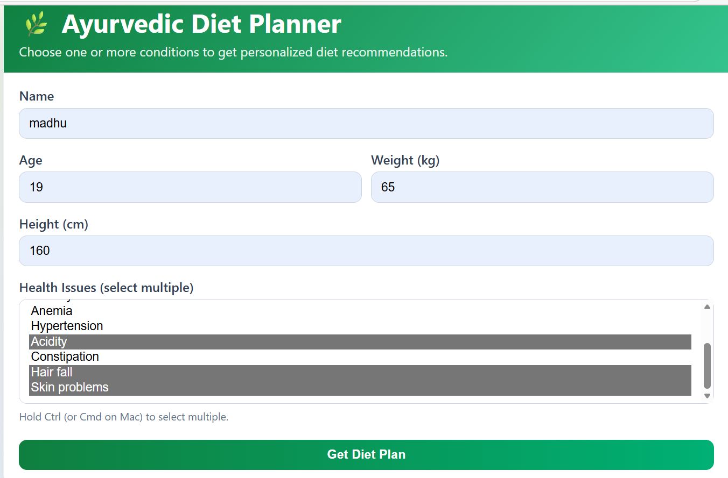
Home page

Slide 18
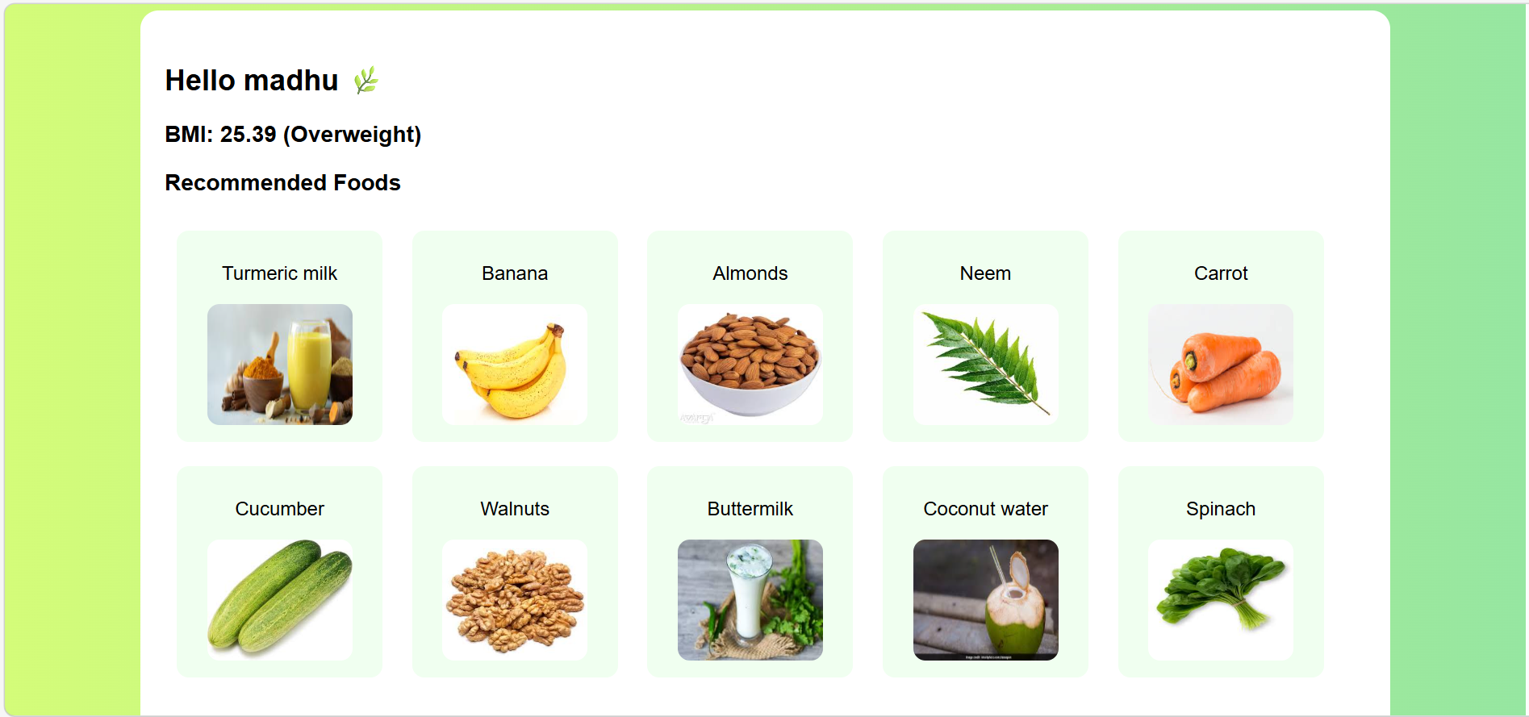

Slide 19
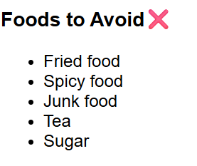
output screen

Slide 20
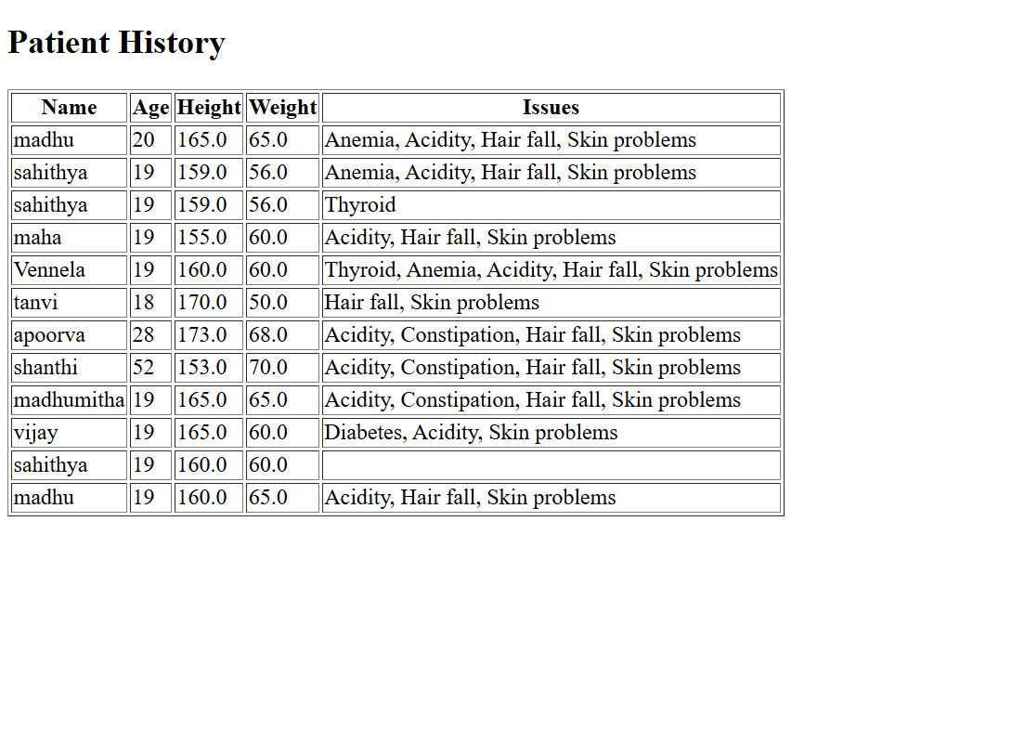
Database

Slide 21
THANK YOU

